Slide 1
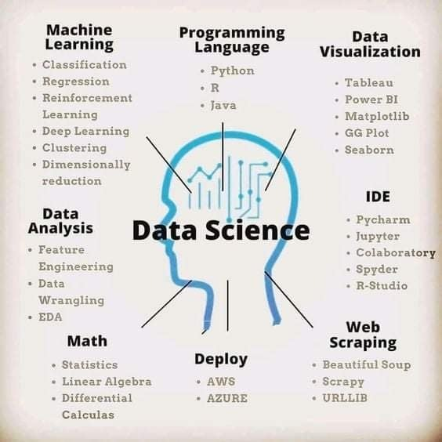
Introduction to Data Science

Slide 2


Introduction
Data Science is an interdisciplinary field that focuses on extracting knowledge from data sets which are typically huge in amount.
The field encompasses analysis, preparing data for analysis, and presenting findings to inform high-level decisions in an organization.
As such, it incorporates skills from computer science, mathematics, statics, inform.
Some of the techniques utilized in Data Science encompass machine learning, visualization, pattern recognition, probability modeling data, data engineering, signal processing, etc.

Slide 3



Prerequisites for Data Science
The following are the three essential traits of Data Scientist:
Curiosity
Curiosity: Only when you ask questions, you will have a better understanding of the business problem.
Common Sense: To identify new ways to solve a business problems and to detect priority problems.
Communication Skills: A Data Scientist needs to communicate their findings to business teams to act upon the insights

Slide 4
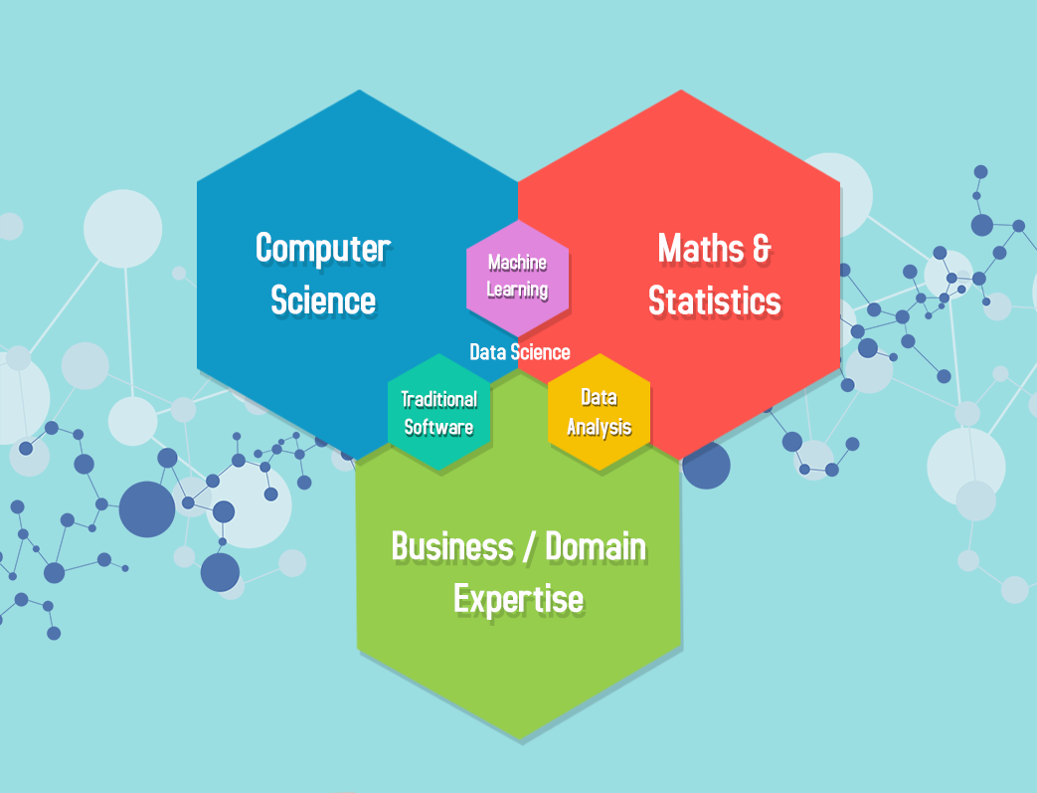
Skills required for Data Scientist
Domain Knowledge:
To get useful information out of raw data that benefits a company’s business.
Know about the business model of the company .
Ask the right questions to produce valuable results.
Math Skills:
Linear Algebra, Calculus, and other concepts of mathematics help us to understand the complex behavior of Machine Learning algorithms.
Probability and statistics are mainly used in predictive modeling and clustering.

Slide 5
Skills required for Data Scientist
Computer Science:
To implement Data Science techniques using programming languages like Python, R, SQL, Scala, Julia, JavaScript, etc.
To deal with varied databases and loud networks to process the data.
Knowledge about algorithms, relational and non-relational databases, Distributed Computing, and Machine Learning.
Communication Skills:
To have good communication when working in team.
To draw conclusions from the data analysis and make presentation.

Slide 6
Data Science Three skill tracks:
Engineering , Modeling , Analysis
Engineering
Involves in building the data pipeline infrastructure.
It involves the software and the hardware used to store the data and perform data ETL (i.e., extract, transform, and load).
Store and compute data on the cloud.
The fundamental building block for automation is maintaining the data pipeline through modular, well-commented code and version control.
Key task involved are:-

Slide 7
Engineering
Key task involved are:-
Data Environment: Designing and setting up the entire environment to support data, science workflow is the prerequisite for data science projects. It may include setting up storage in the cloud, Kafka platform, Hadoop and Spark cluster, etc
Data Management: Automated data collection, that includes parsing the logs (depending on the stage of the company and the type of industry you are in), web scraping, API queries, and interrogating data streams. Determine and construct data schema to support analytical and modeling needs. Use tools, processes, guidelines to ensure data is correct, standardized, and documented.
Production: Involves the whole pipeline from data access, preprocessing, modeling to final deployment. It is necessary to make the system work smoothly with all existing software stacks.

Slide 8
Data Science Three skill tracks:
Analysis
Analysis turns raw information into insights in a fast and often exploratory way.
In general, an analyst needs to have decent domain knowledge, do exploratory analysis efficiently, and present the results using storytelling.
Key point includes are:-
Domain Knowledge: understanding of the organization or industry where you apply data science. You can’t make sense of data without context.
Exploratory Analysis: team look at as much data as possible so that the decision-makers can get a sense of what’s worth further pursuing. It often involves different ways to slice and aggregate data.
Storytelling: It is the art of telling people what the numbers signify. It usually requires data summarization, aggregation, and visualization. It is crucial to answering the following questions before you begin down the path of creating a data story.
• Who is your audience?
• What do you want your audience to know or do?
• How can you use data to help make your point?

Slide 9
Data Science Three skill tracks:
Modeling
A process that dives deeper into the data to discover the pattern we don’t readily see.
A model only occupy a small part of a typical data scientist’s day-to-day time.
Some of the models are :-
Supervised Learning: In supervised learning, each sample corresponds to a response measurement. There are two flavors of supervised learning: regression and classification.
In regression, the response is a real number, such as the total net sales in 2017 for a company or the yield of corn next year for a state.
The goal for regression is to approximate the response measurement as much as possible.
In classification, the response is a class label, such as a dichotomous response of yes/no.
The response can also have more than two categories, such as four segments of customers

Slide 10
Un-supervised Learning: In unsupervised learning, there is no response variable. Clustering approach is used for data analysis.
Customized model development: A data scientist may need to develop new models to accommodate the subtleties of the problem at hand. For example, people may use Bayesian models to include domain knowledge as the modeling process’s prior distribution.

Slide 11
Data Science Prerequisites
What type of problem you are solving?
Description:
The primary analytic problem is to summarize and explore a data set with descriptive statistics (mean, standard deviation, and so forth) and visualization methods.
Data description is often used to check data, find the appropriate data preprocessing method, and demonstrate the model results.
Comparison :
The first common modeling problem is to compare different groups. Is A better in some way than B? Or more comparisons: Is there any difference among A, B, and C in a particular aspect?
The commonly used statistical tests are chisquare test, t-test, and ANOVA. There are also methods using Bayesian methods.

Slide 12
Data Science Prerequisites
Clustering :
Please note that clustering is unsupervised learning; there are no response variables. The most common clustering algorithms include K-Means and Hierarchical Clustering.
Classification :
For classification problems, there are one or more label columns to define the ground truth of classes. We use other features of the training dataset as explanatory variables for model training. We can use the trained classifier to predict the labels of a new observation.
The random forest algorithm is usually used as the baseline model to set model performance expectations.

Slide 13
Data Science Prerequisites
Regression :
Generally used for prediction and to answer the questions:-
What will be the temperature tomorrow? What is the projected net income for the next season? How much inventory should we have?
Optimization :
It is an expansion of comparison problem and can solve problems such as:
What is the best route to deliver the packages? What is the optimal advertisement strategy to promote a new product?.

Slide 14


